Slide 1
StockX Sale Data
Robert Carter

Slide 2
The Data
This Data Comes from StockX
Part of an open-source contest
StockX is a secondary market for athletic shoes, apparel, and technology that is in high demand

Slide 3
Data Continued
The data has about 100,00 records
There are 7 columns of data

Slide 4
Objective
Establish model that can predict high resale shoes.
Will use machine learning for Modeling
R is the tool used
Focusing on Linear Regression, Decision Tree, and Anova testing

Slide 5
Hypothesis
H0:The sale price mean will not be different between brands
H1:The sale price mean will be different between brands

Slide 6



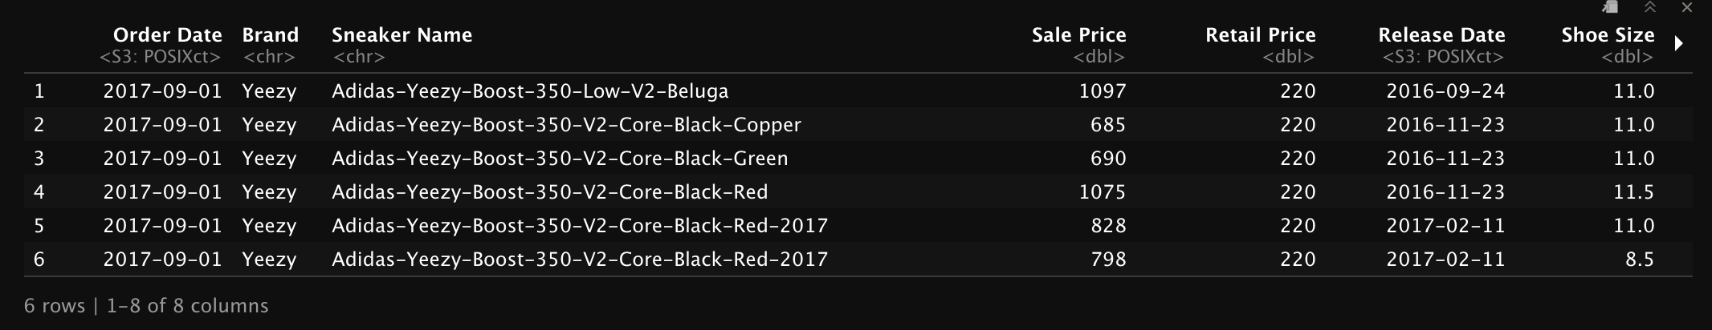
EDA – Exploratory Data Analysis
The Yeezy brand has a high significance to the data
Brand, Release Date, Retail Price, and shoes size is also significant
Median sale price (resale price) is > $370

Slide 7
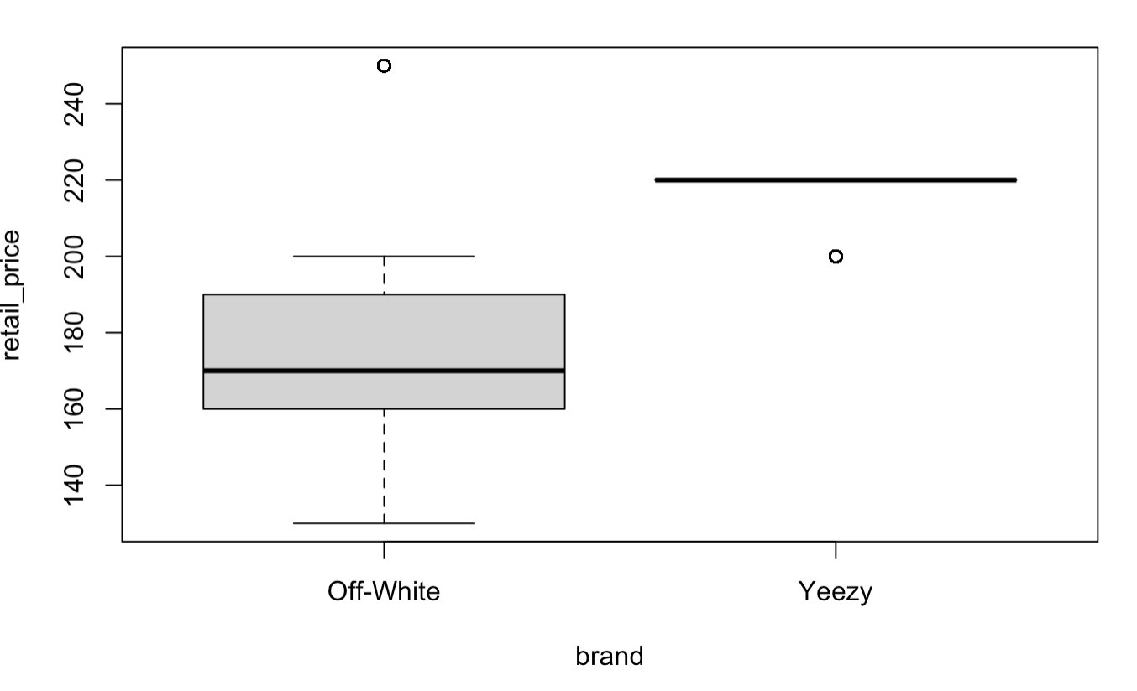
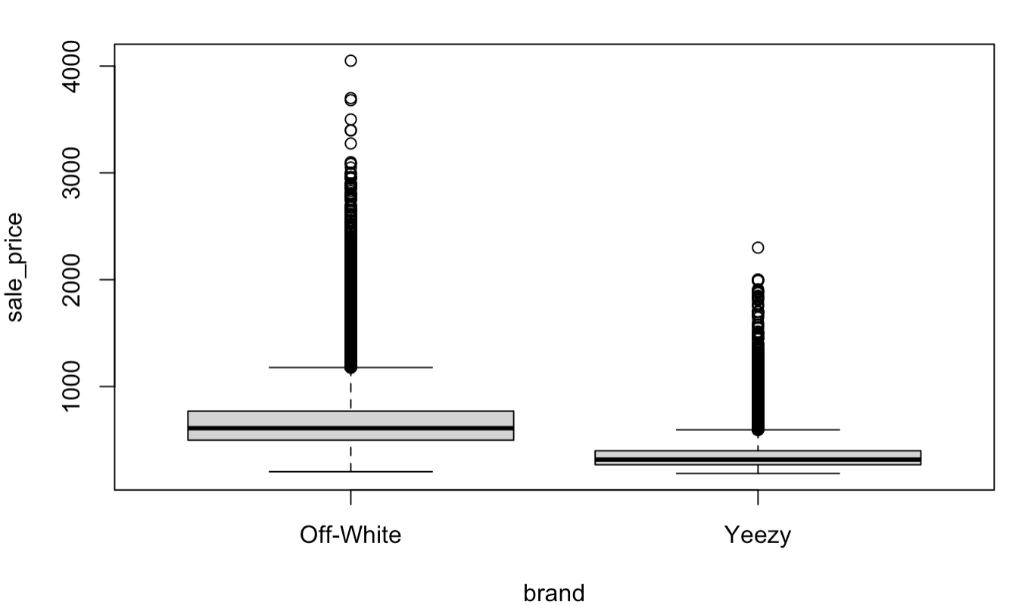
EDA Continued
Off-White has higher resale price than Yeezy
Off-White has a lower retail price than Yeezy

Slide 8
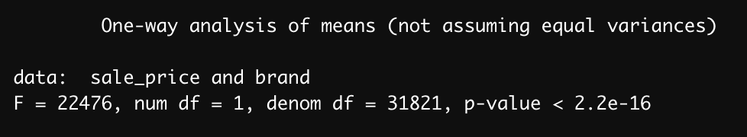
One Way Test
Used One-way anova test to see if there is any significance in the mean for sale price between brands. There is high significance in the means, therefore we do not reject the null hypothesis.

Slide 9
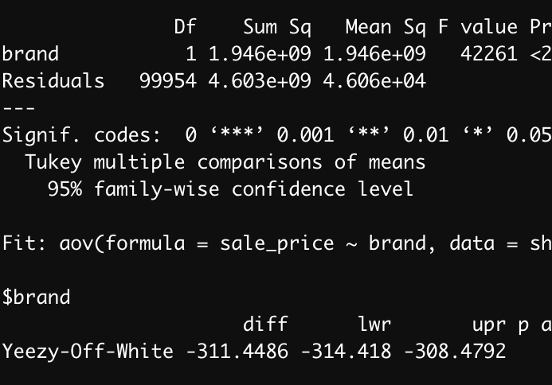
Anova Test
Double checking the one-way test results with an anova test and Tukey multiple pairwise-comparisons. The results are again significant and the Tukey comparison shows a $311 difference between sale price.

Slide 10
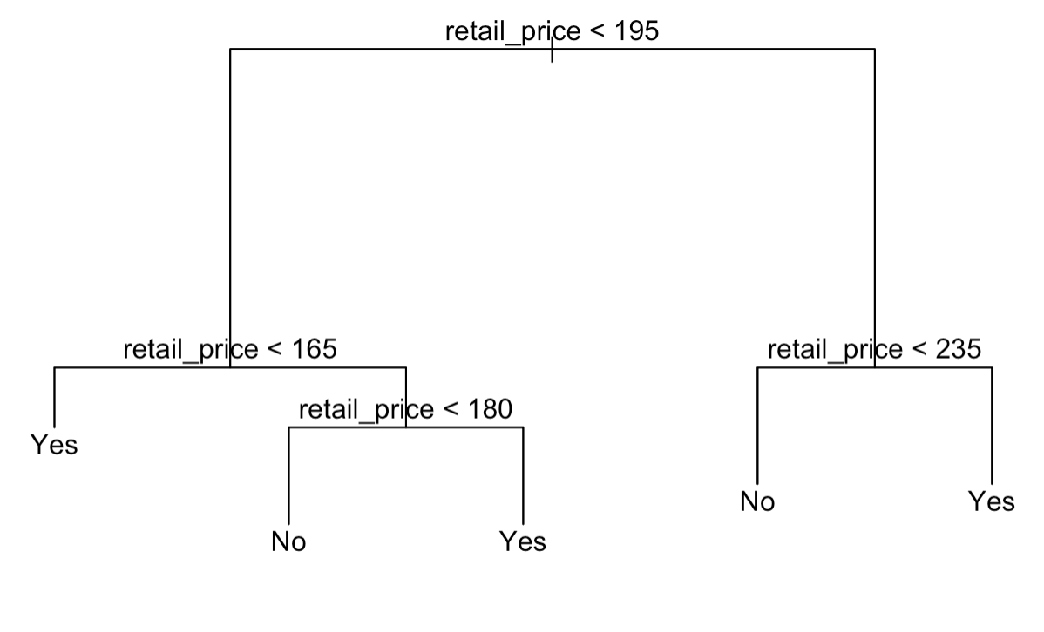
Decision Tree
Retail price under 165 has a good chance of having a high resale price
Retail price is greater than 180 then the resale price will be high
If retail price is greater than 235 the resale price will be high

Slide 11
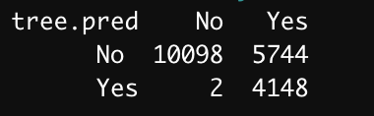
Predict High Resale Shoes
Split into Train and Test
Retail price main driver in tree
Once model was trained applied test data
42% accuracy

Slide 12
Conclusion
Retail price does not necessarily equate to higher resale value
The initial significance of Yeezy did not reflect the higher resale value of Off-White
Able to accurately predict high resale value 42% of the time
Biggest lesson learned was understanding the data is key to a good analysis

Slide 13
Appendix
https://stockx.com/news/the-2019-data-contest/
https://www.datacamp.com/community/tutorials/decision-trees-R
https://www.guru99.com/r-decision-trees.html#3
https://rpubs.com/ID_Tech/S1

